Slide 1
Deep Learning
Natural Language Processing applications

Slide 2
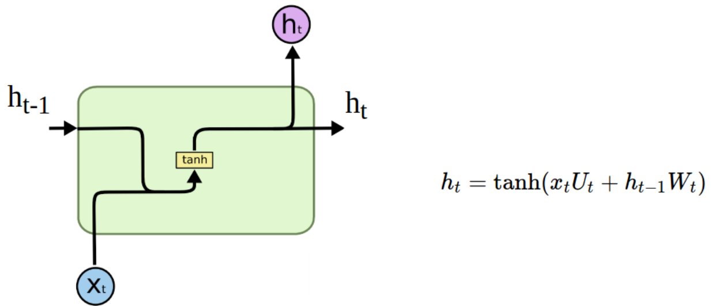
Recurrent neural network (RNN)
history-aware NN for sequential data
API: new_memory = f(current_input, old_memory)
Vanilla RNN cell. Snapshot from http://colah.github.io/posts/2015-08-Understanding-LSTMs/

Slide 3
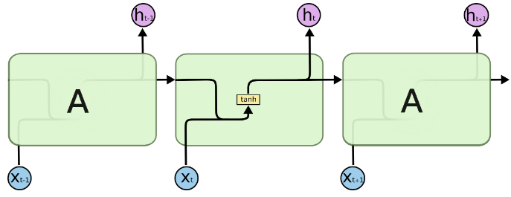
Unrolling vanilla RNN
apply same computation at each timestep
we get a new memory/hidden state at each timestep
how is information from x_{t+1} connected to x_{t-1}?
Unrolled vanilla RNN cell. Snapshot from http://colah.github.io/posts/2015-08-Understanding-LSTMs/

Slide 4
Unrolling vanilla RNN
apply same computation at each timestep
we get a new memory/hidden state at each timestep
how is information from x_{t+1} connected to x_{t-1}?
through hidden state h_{t}
Unrolled vanilla RNN cell. Snapshot from http://colah.github.io/posts/2015-08-Understanding-LSTMs/

Slide 5
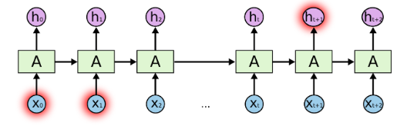
Vanilla RNN for long-term dependencies
in theory, vanilla RNN can learn long-term dependencies
in practice, vanishing gradients prevent RNN from preserving information over many timesteps
Unrolled vanilla RNN cell. Snapshot from http://colah.github.io/posts/2015-08-Understanding-LSTMs/

Slide 6
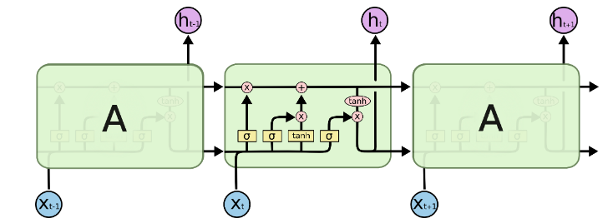
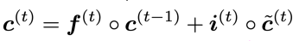
LSTM for long-term dependencies
gates block information or let it flow
they control the importance of current info and past memory
they help with learning long-term dependencies (but these can still be tricky to learn)
c_{t-1}
c_{t}
f_{t}
i_{t}
Unrolled vanilla RNN cell. Snapshot from http://colah.github.io/posts/2015-08-Understanding-LSTMs/

Slide 7
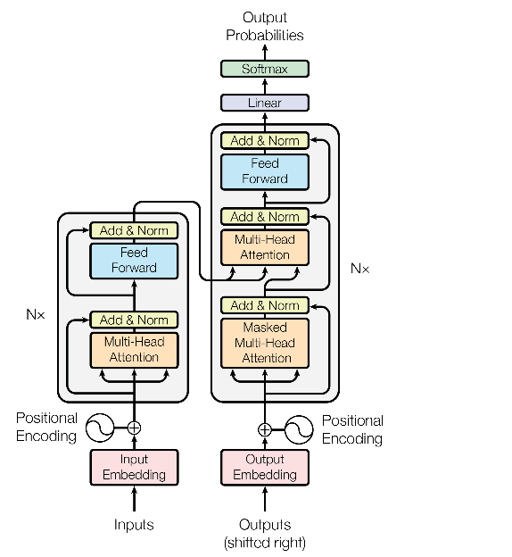
Transformer block - recap
recurrent-free, parallelizable alternative for sequence processing
lower complexity than RNNs: O(N²d) vs O(Nd²)
constant gradient path (every element directly interacts with all the other elements)
building block for SOTA architectures in NLP (BERT, GPT-2)

Slide 8
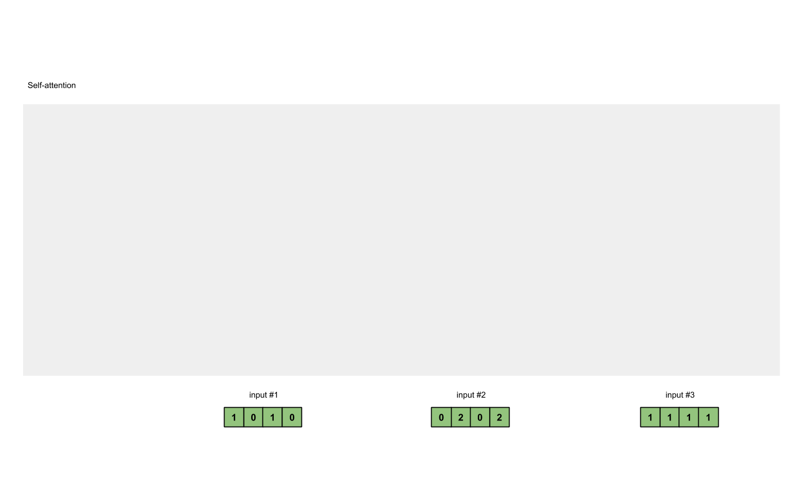

Sequential architectures recap
in RNNs, sequence elements are processed step by step
in self-attention, sequence elements are processed all at once
source self-attention https://towardsdatascience.com/illustrated-self-attention-2d627e33b20a

Slide 9
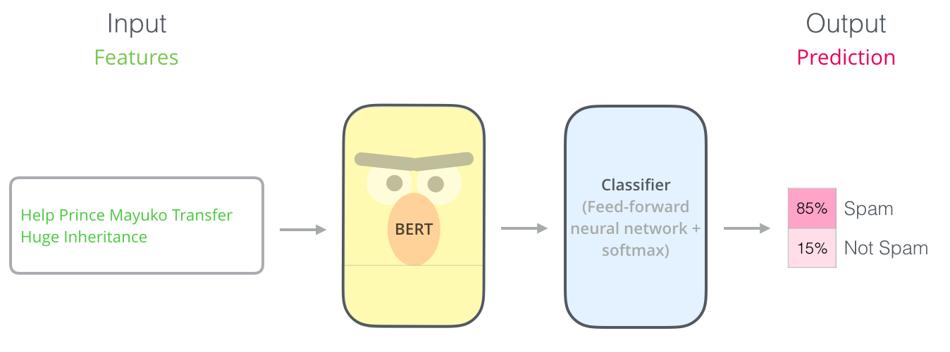
Spam classification
source: https://jalammar.github.io/illustrated-bert/

Slide 10
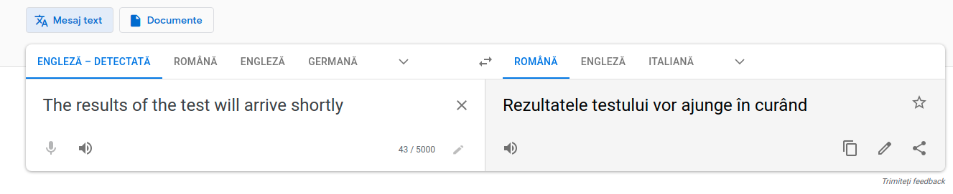
Neural Machine Translation
2016: Google Translate is powered by single end-to-end Neural Network (Wu et al. 2016)

Slide 11
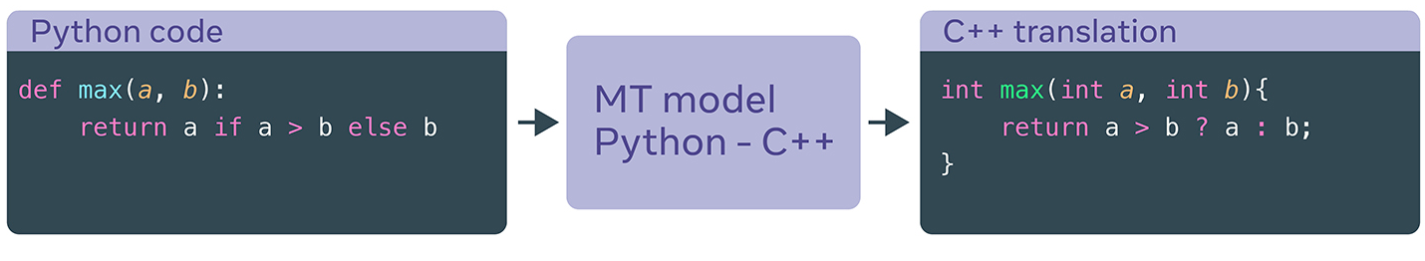
Unsupervised Translation of Programming Languages (Lachaux et al. 2020)
translate one programming language to another (w/o pair supervision)

Slide 12
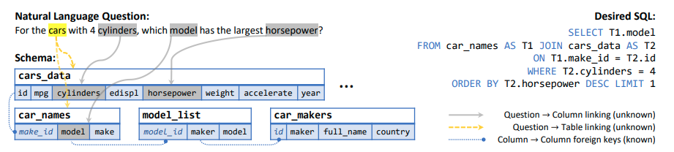
text-to-SQL generation (Wang et al. 2020)
given a user’s request and a database schema, generate the SQL that solves the user’s request
figure from Wang et al. 2020

Slide 13
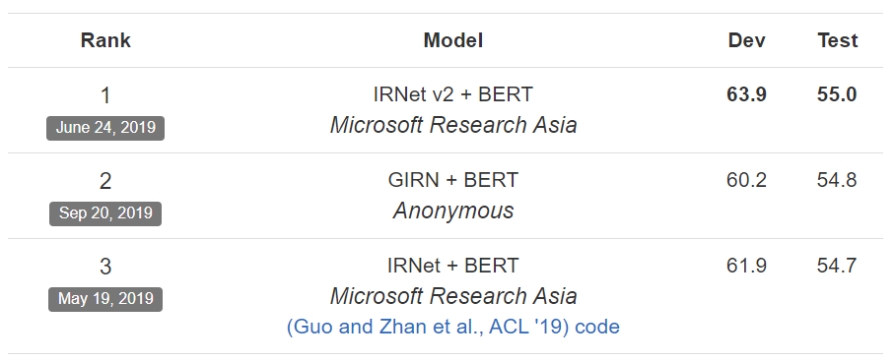
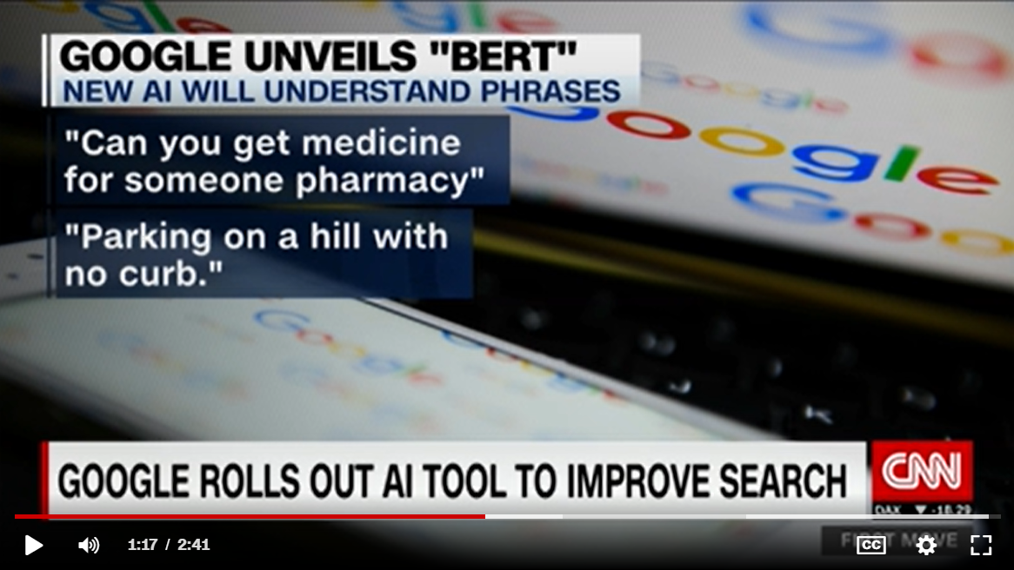
BERT (Google 2018)
BERT features useful for transfer learning => SOTA results on many NLP tasks
industry adoption (powering Google Search)

Slide 14
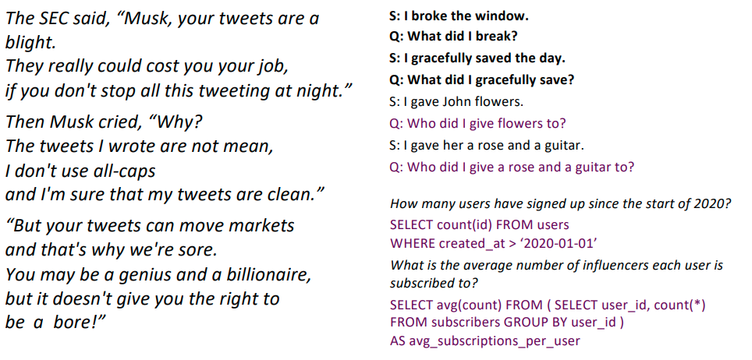
OpenAI GPT-3 (Brown et al. 2020)
175B parameters
generates human-like poetry, code, dialogue
solves NLP tasks in zero/few-shot way

Slide 15
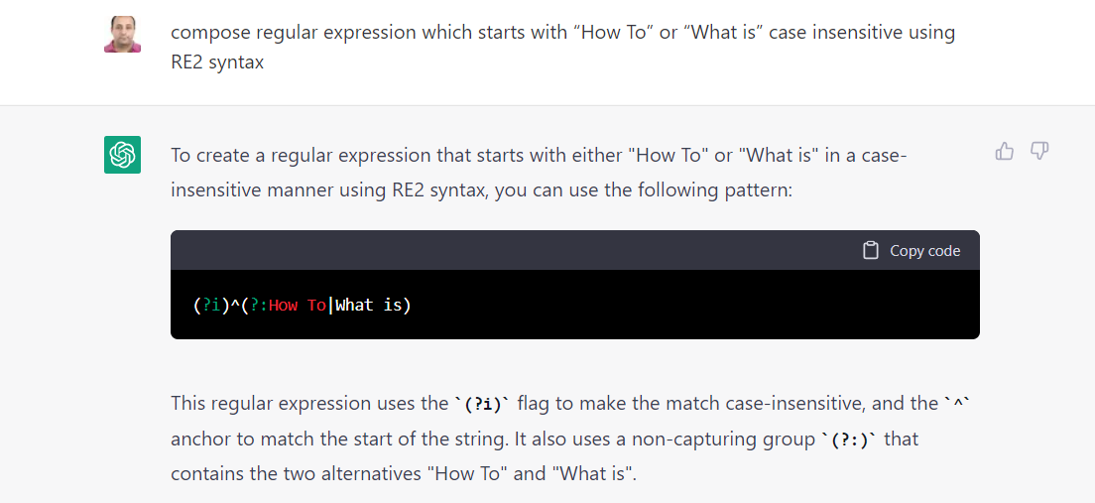
chatGPT (OpenAI 2022)
chatbot based on GPT3.5
solves NLP tasks or novel requests in zero/few-shot way
takes into account previous chat interactions
source https://www.searchenginejournal.com/chatgpt-examples/474937/

Slide 16

chatGPT (OpenAI 2022)
solves complex programming tasks while reasoning step-by-step about its process

Slide 17
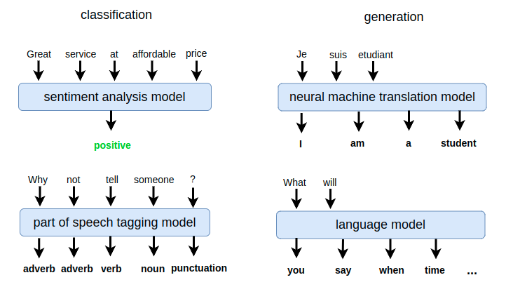
NLP application types
classification tasks:
many-to-one (text-level classification)
many-to-many (token-level classification)
generation tasks:
many-to-many (neural machine translation, text summarization, language modeling etc.)

Slide 18
Outline
tokenization
static word embeddings
word2vec (algo. for computing word embeddings)
transfer learning with static word embeddings (sentence classification with RNN and CNN)
contextual word embeddings
ELMO
BERT
Large Language Models

Slide 19
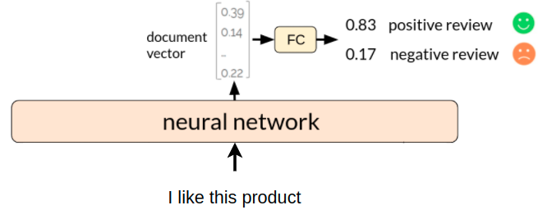
NN for text classification

Slide 20
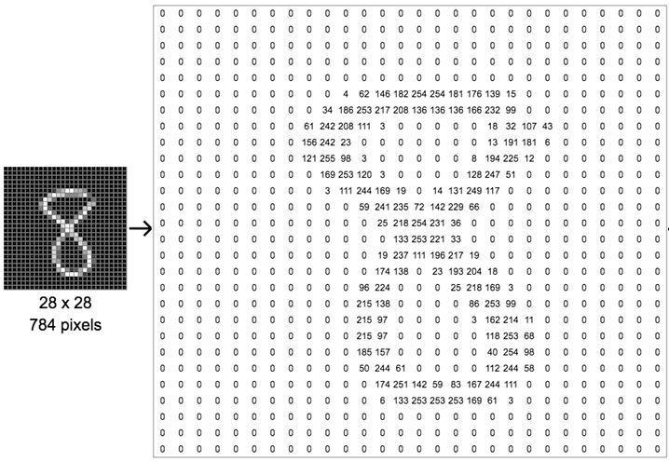
Numerical representation
we know how to represent an image with numbers

Slide 21
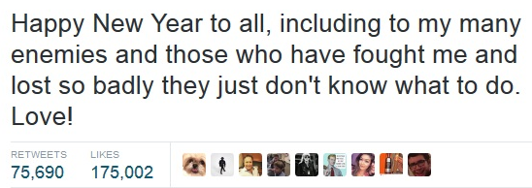

Numerical representation
we know how to represent an image with numbers
but how do we represent a text with numbers?

Slide 22
First, how do we split text?
split into characters
‘H’, ‘a’, ‘p’, ‘p’, ‘y’, ‘ ‘, ‘N’, ‘e’, ‘w’, ‘ ‘, ‘Y’, .... , ‘L’, ‘o’, ‘v’, ‘e’, ‘!’

Slide 23
First, how do we split text?
split into characters
‘H’, ‘a’, ‘p’, ‘p’, ‘y’, ‘ ‘, ‘N’, ‘e’, ‘w’, ‘ ‘, ‘Y’, .... , ‘L’, ‘o’, ‘v’, ‘e’, ‘!’
split into words
‘Happy’, ‘New’, ‘Year’, ‘to’, ‘all’, ‘,’, ‘including’, ..., ‘Love’, ‘!’

Slide 24
First, how do we split text?
split into characters
‘H’, ‘a’, ‘p’, ‘p’, ‘y’, ‘ ‘, ‘N’, ‘e’, ‘w’, ‘ ‘, ‘Y’, .... , ‘L’, ‘o’, ‘v’, ‘e’, ‘!’
split into words
‘Happy’, ‘New’, ‘Year’, ‘to’, ‘all’, ‘,’, ‘including’, ..., ‘Love’, ‘!’
split into wordpieces
‘Happy’, ‘New’, ‘Year’, ‘to’, ‘all’, ‘,’, ‘includ’, ‘##ing’, ..., ‘Love’, ‘!’

Slide 25

Tokenization
process by which we split text into smaller units, called tokens
tokens can correspond to linguistic words (‘hello’), but it’s not always the case (‘nlp2018’)
hello, my, name, is, Anne, and, I, write, …
https, www, mit, com, class, nlp2018, assignments, hw1, pdf

Slide 26
Say we split text into words, how do we encode them?
tokenize text
‘Happy’, ‘New’, ‘Year’, ‘to’, ‘all’, ‘,’, ‘including’, ..., ‘Love’, ‘!’
encode
words
‘Happy’ = ?
‘New’ = ?
…
‘!’ = ?

Slide 27
One-hot representation for words
…
car = [0 0 0 0 0 1 0 0 0 0 0 0 0 0 0 0 0 0 0 0 0 … ]
vocabulary …
bus = [0 0 0 0 0 0 0 0 0 0 0 0 0 0 1 0 0 0 0 0 0 … ]
....
simplest representation (makes no assumptions)
vectors are orthogonal (don’t capture similarity)
size = number of words in vocabulary

Slide 28
Dense representation for words (embeddings)
…
car = [0.12 0.17 0.93 … 0.10 0.98]
vocabulary …
bus = [0.64 0.07 0.86 … 0.23 0.56]
....
each word is represented by a dense feature vector
these vectors are not handcrafted, but learned by a network
size ∈ [50, 1000]

Slide 29
Dense representation for words
‘vehicleness’
…
car = [0.12 0.17 0.93 … 0.10 0.98]
vocabulary cat = [0.41 0.15 0.17 … 0.81 0.20]
bus = [0.64 0.07 0.86 … 0.23 0.56]
....
dimensions could encode different properties (not always interpretable)
size ∈ [50, 1000]

Slide 30
Dense representation for words
‘vehicleness’
‘animal’
…
car = [0.12 0.17 0.93 … 0.10 0.98]
vocabulary cat = [0.41 0.15 0.17 … 0.81 0.20]
bus = [0.64 0.07 0.86 … 0.23 0.56]
....
dimensions could encode different properties (not always interpretable)
size ∈ [50, 1000]

Slide 31
Dense representation for words
‘vehicleness’
…
car = [0.12 0.17 0.93 … 0.10 0.98]
vocabulary cat = [0.41 0.15 0.17 … 0.81 0.20]
bus = [0.64 0.07 0.86 … 0.23 0.56]
....
dimensions could encode different properties (not always interpretable)
similar words (‘car’, ‘bus’) will tend to have similar features
size ∈ [50, 1000]
Notes:
Recommender systems:

Slide 32
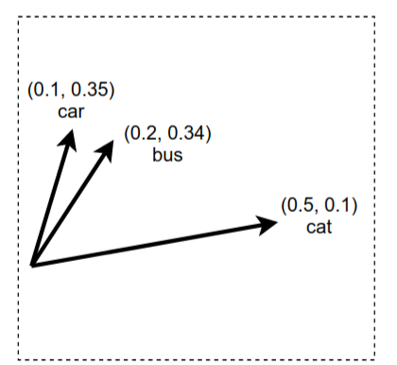
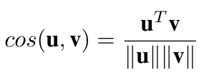
Measure words similarity
Using their word vectors :
dot product: u^{T}v
cosine similarity:
similarity(car, bus) = (0.1 * 0.2 + 0.35 * 0.34) / 0.145 = 0.95
similarity(car, cat) = (0.1 * 0.5 + 0.35 * 0.1) / 0.186 = 0.46

Slide 33
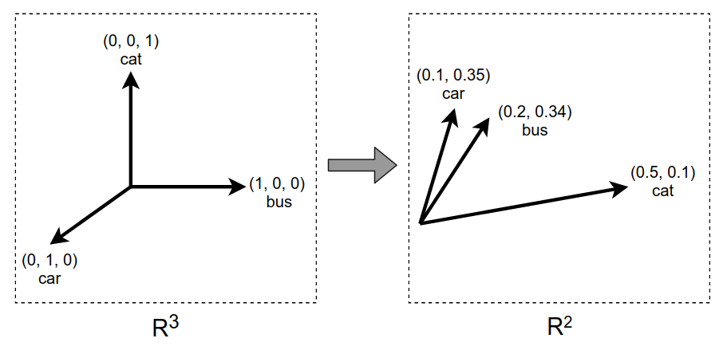
One-hot vs dense vectors
one-hot vectors:
words are equally distant in vector space
dense vectors (embeddings):
similar words have similar vectors
vs

Slide 34
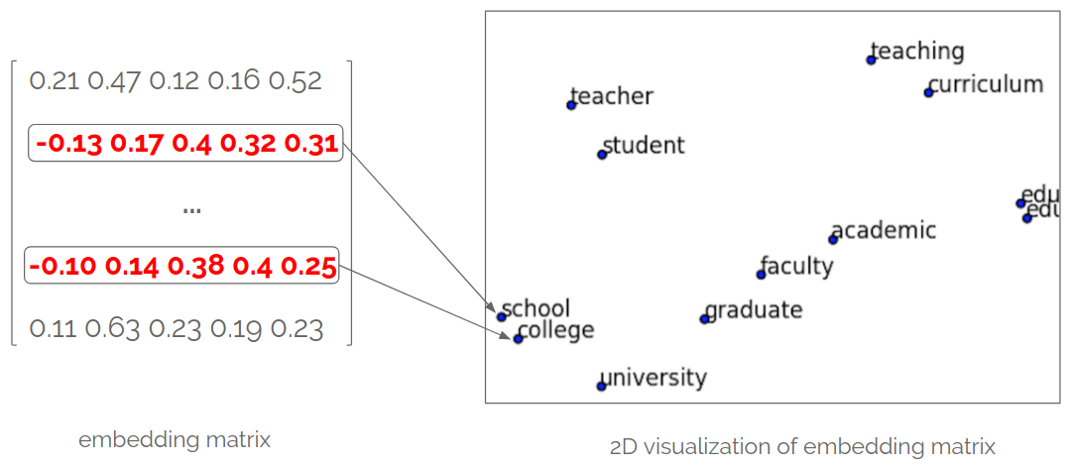
Visualizing word embeddings
number_of_words x 300

Slide 35
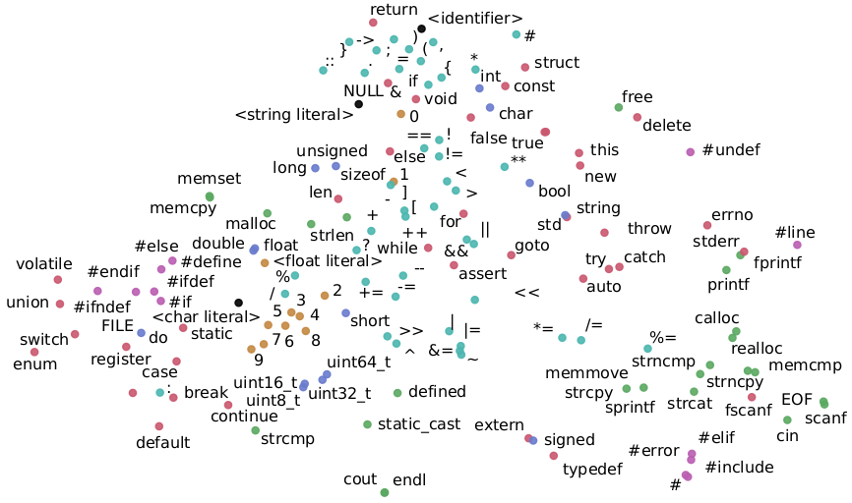
Visualizing embeddings for code tokens
‘words’ here are C/C++ code tokens
paper: Automated software vulnerability detection with machine learning, Harer et. al 2018

Slide 36
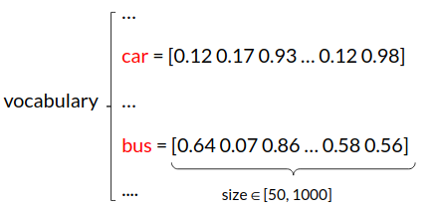
Having word vectors is nice, but how do we obtain them?

Slide 37
Having word vectors is nice, but how do we obtain them?
the word vectors are just parameters that the network will adjust during training

Slide 38
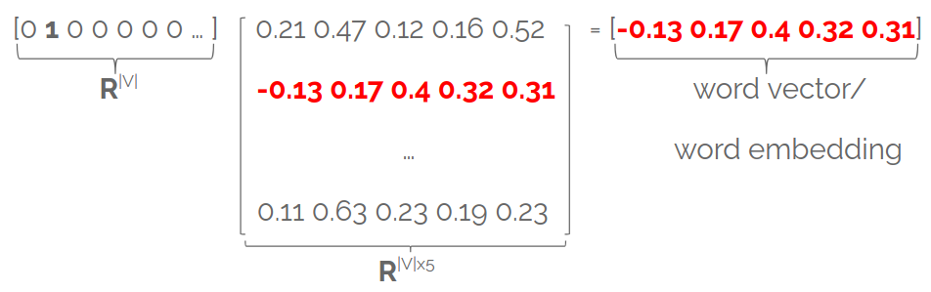
Embedding layer
stores word embeddings (one word per row) in a matrix E
E∈^{|V| x d} is the embedding matrix (learnable weights)

Slide 39
Embedding layer
stores word embeddings in a matrix E∈^{|V| x d}
each row in E is a word embedding associated with a given word
matrix E is fully learnable!
you can think of it as a fully-connected layer applied to one-hot vectors

Slide 40
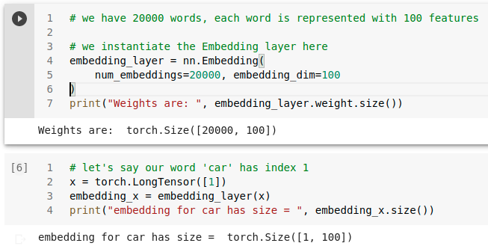
Embedding layer in PyTorch
we feed the indices of the words to the embedding layer

Slide 41
How do we get word embeddings?
by training a neural network on a particular task T
network will learn both:
how to represent words with features (embeddings)
how to solve the task T based on the embeddings (which are continually adjusted)

Slide 42

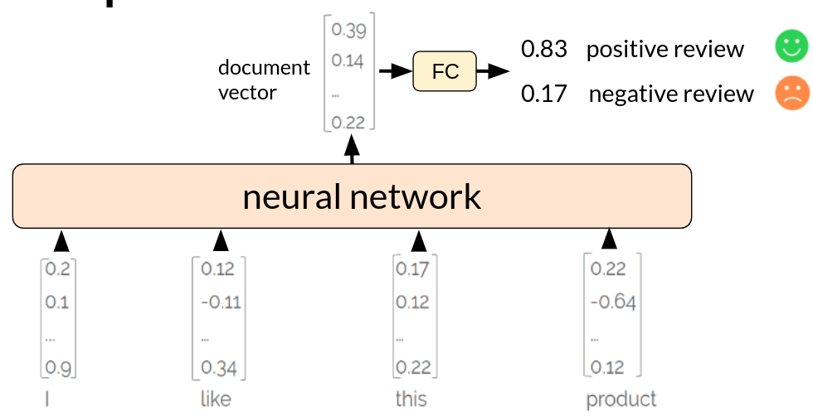
NN for text classification
Model learns word embeddings/features and how to combine these features for classification
neural network layers
word embedding layer
(randomly initialized)
students
...

Slide 43
NN for text classification
Model learns word embeddings/features and how to combine these features for classification
neural network layers
word embedding layer
students
...
What if we don’t want to learn word features from scratch?

Slide 44
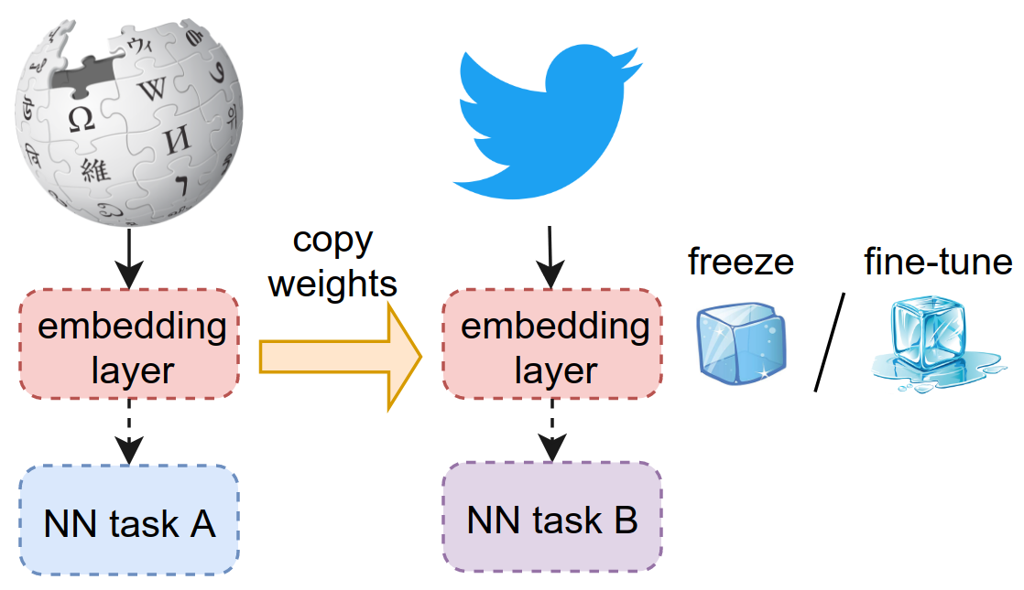
word2vec (Mikolov et al 2013)
Algorithm that learns general-purpose word vectors from lots of text
transfer learning: these word vectors can be used to initialize the embedding layer of another network

Slide 45
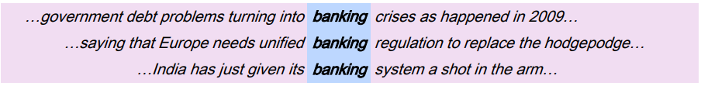
Find word based on its context
the same word is missing from each sentence
adapted from Stanford Deep Learning Course, Lecture 1 http://web.stanford.edu/class/cs224n/slides/cs224n-2019-lecture01-wordvecs1.pdf

Slide 46
Meaning is context
a word’s meaning is given by the words nearby (context)
idea: use the many contexts in which ‘banking’ appears in order to build a word vector for ‘banking’
from Stanford Deep Learning Course, Lecture 1 http://web.stanford.edu/class/cs224n/slides/cs224n-2019-lecture01-wordvecs1.pdf

Slide 47
word2vec (skip-gram) idea
A simple classifier that learns word vectors from lots of text (Wikipedia)
Binary classification task: is word c a real context word for target word t?
drive many miles by car

Slide 48
word2vec (skip-gram) idea
A simple classifier that learns word vectors from lots of text (Wikipedia)
Binary classification task: is word c a real context word for target word t?
drive many miles by car
Classifier predicts:
high probability for likely (context, target) pairs:
P(context=real | c = drive, t = miles) = 0.86
P(context=real | c = car, t = miles) = 0.73
low probability for unlikely (context, target) pairs:
P(context=real | c = tomato, t = miles) = 0.13

Slide 49
word2vec training data (positive examples)
Running window over large quantities of text:
drive many miles by car
many miles by car to
miles by car to get
by bus to get to
bus to get to school

Slide 50
word2vec training data (negative examples)
Corrupt positive examples: replace context words with random words:
drive many miles by car
recipe

Slide 51
word2vec training data pairs
Positive (target, context) examples: Negative (target, context) examples:
miles drive miles recipe
miles many miles frontend
miles by miles fever
miles car miles lemon
… ...

Slide 52
How to compute probability?
two words t and c are similar if their word vectors have high dot product:
similarity(t, c) ≈ t·c
miles
drive
tomato

Slide 53
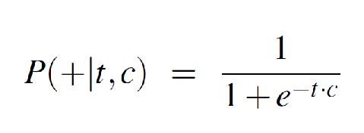
How to compute probability?
two words t and c are similar if their word vectors have high dot product:
similarity(t, c) ≈ t·c
probability that word c is the real context for target t:
miles
drive
tomato

Slide 54
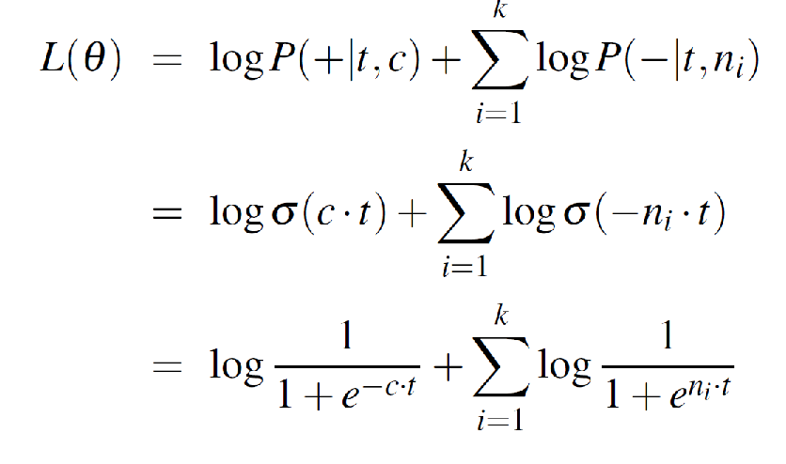
Learning objective
1 real (t, c) pair and k fake (t, n_{i}) pairs:
maximize these probabilities

Slide 55
Learning objective
1 real (t, c) pair and k fake (t, n_{i}) pairs:
maximize dot product between
target word t and real context word c

Slide 56
Learning objective
1 real (t, c) pair and k fake (t, n_{i}) pairs:
minimize dot product between
target word t and fake context word n_{i}

Slide 57
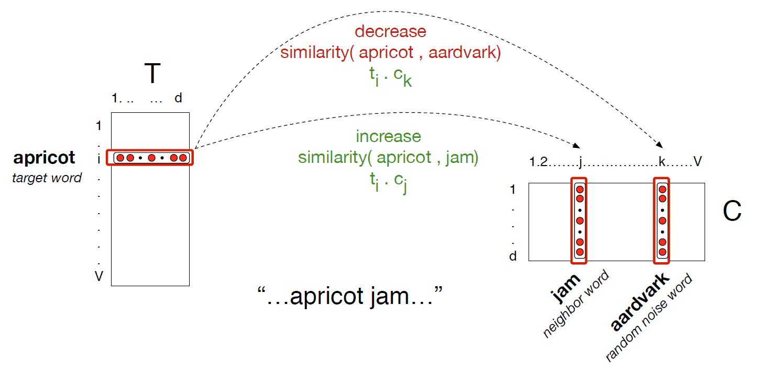
Shift embeddings during training
from Speech and Language Processing 3rd edition, Manning and Jurafsky

Slide 58
Word embeddings after training
number_of_words x 300

Slide 59
NN for text classification
Model ‘knows’ how to represent the words and only has to learn how to aggregate them into a document vector
neural network layers
word embedding layer
students
...
initialized with pretrained word embeddings such as word2vec, Glove etc.

Slide 60
Transfer word embeddings
initialize word embedding layer with pretrained word embeddings (word2vec, GloVe, etc.)
either:
freeze word vectors on the new task B
fine-tune vectors on the new task B

Slide 61
Checkpoint 1
Tokenization
split text into smaller parts, called tokens
Word embeddings/word vectors
semantically-aware vectors (similar words have similar vectors)
Word2vec (negative sampling skip-gram)
algorithms that obtain general-purpose word embeddings
trains binary classifier to distinguish real (word, context) pairs from fake ones
vectors of similar words are pushed to space where they have high similarity
Transfer learning
initialize word embedding layer on a new task with pre-trained word embeddings: word2vec, Glove, fastText, etc.

Slide 62
NN for text classification
How does this network look like? Could we aggregate the word embeddings without a neural network?
neural network layers
word embedding layer
students
...

Slide 63
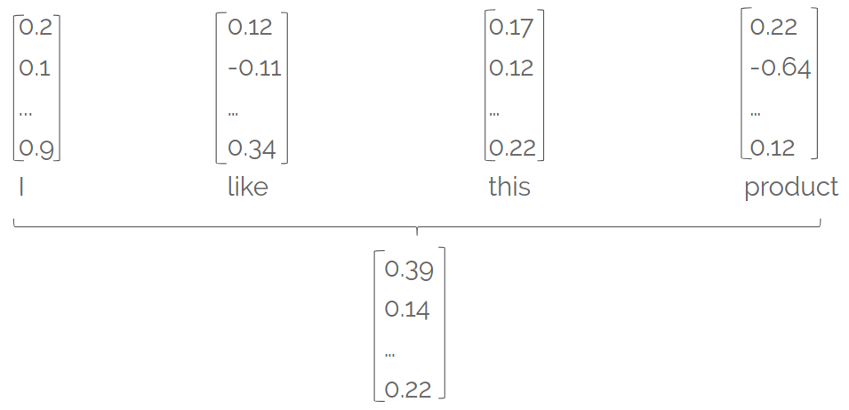
From word vectors to document vector
Goal: find vector representation for a document (sentence/paragraph), starting from word vectors
document vector/embedding

Slide 64
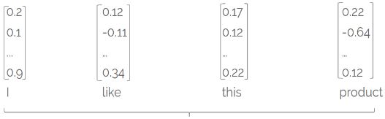
Bag of word embeddings
document vector = average/sum of word vectors
+
+
+

Slide 65
NN for text classification
Train MLP over bag of word embeddings
FC layers
word embedding layer
students
...
average/sum

Slide 66
Bag of word embeddings - drawbacks
document vector = average/sum of word vectors
+
+
+
however, order is discarded:
the movie wasn’t bad, it was actually quite good
the movie wasn’t good, it was actually quite bad

Slide 67
Bag of word embeddings - drawbacks
document vector = average/sum of word vectors
+
+
+
different meanings, same document vector
however, order is discarded:
the movie wasn’t bad, it was actually quite good
the movie wasn’t good, it was actually quite bad

Slide 68
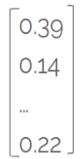


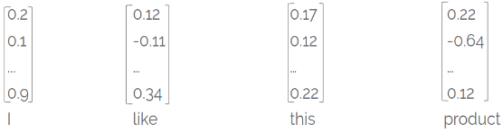
NN for text classification
0.83 positive review
0.17 negative review
we need a more complex model that:
aggregates word vectors
takes word order into consideration
document vector
FC
neural network

Slide 69
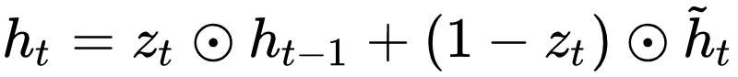
Visualizing hidden states
each hidden state h_{t} aggregates info from:
current timestep x_{t}
the past (stored in the previous hidden state h_{t-1})
what is the value of z_{t} based on the diagram?
Unrolled RNN gif from https://towardsdatascience.com/illustrated-guide-to-recurrent-neural-networks-79e5eb8049c9

Slide 70
Visualizing hidden states
each hidden state h_{t} aggregates info from:
current timestep x_{t}
the past (stored in the previous hidden state h_{t-1})
what is the value of z_{t} based on the diagram?
z_{t} = [0.5 0.5 … 0.5]
Unrolled RNN gif from https://towardsdatascience.com/illustrated-guide-to-recurrent-neural-networks-79e5eb8049c9

Slide 71

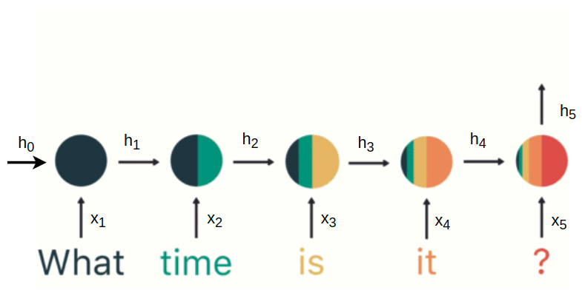
Visualizing hidden states
Final hidden state h₅
aggregates information from the whole sequence
takes order into consideration
source

Slide 72
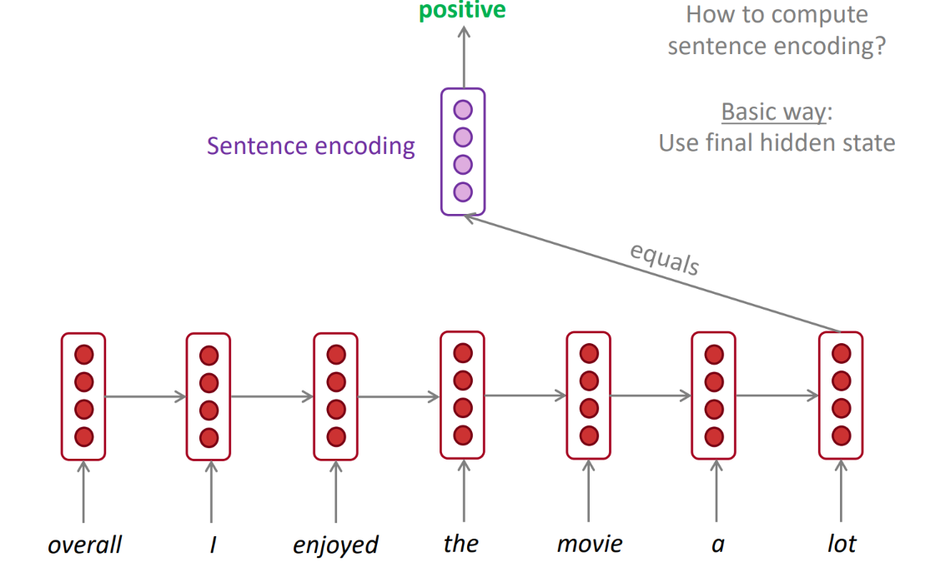
Last hidden state as sentence embedding
Training:
compute last hidden state using RNN => h_{t}
apply fully-connected layer to h_{t} (+softmax) to get class probabilities:
p = softmax(Wh_{t}+b)
cross-entropy loss
0.73 positive sentiment
0.27 negative sentiment
FC
h₇
h₁
h₂
h₃
h₄
h₅
h₆
source: Stanford CS224, lecture 6

Slide 73

Last hidden state problem
last hidden state h₅ is biased towards information from the end of the sequence
information from the beginning of the sequence more likely to ‘wash away’ (even with good gradients)
source

Slide 74
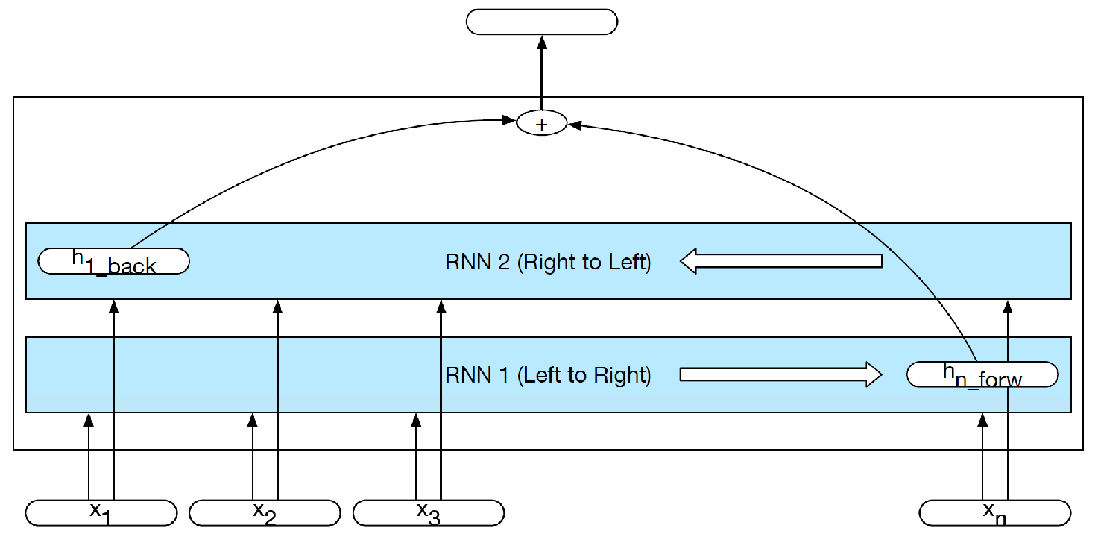
Bidirectional LSTMs
train separate left->right and right->left LSTMs
process both final hidden states (concatenate/add) to make prediction
information from the beginning of the sequence more easily integrated
document embedding
0.73
0.27
FC
from Speech and Language Processing 3rd edition, Manning and Jurafsky

Slide 75
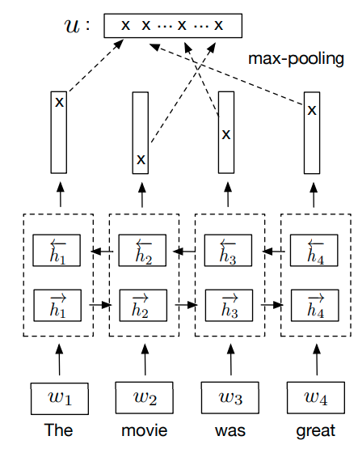
Bidirectional LSTMs with maxpooling
document embedding
0.73
0.27
train separate left->right and right->left LSTMs
concatenate hidden states from both directions at each timestep
apply max-pooling over time to select most salient neuron at each timestep
superior results over other sentence encoders (Conneau et al. 2018)
FC
source
Notes:
https://pratyushmaini.github.io/Pooling-Analysis/ https://arxiv.org/pdf/2005.00159.pdf
pooling helps with vanishing gradient and reduces positional bias

Slide 76
NN for text classification
0.83 positive review
0.17 negative review
can we think of another type of network to process input sequence?
document vector
FC
neural network

Slide 77
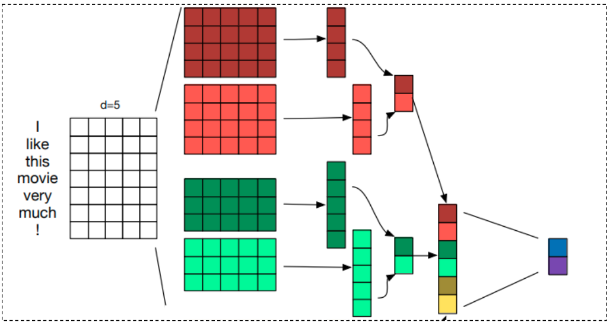
CNN sequence encoder
key operations:
1D convolution filters (different kernel sizes to capture n-grams of varying length)
max pooling over time
adapted from A Sensitivity Analysis of (and Practitioners’ Guide to) Convolutional Neural Networks for Sentence Classification
Notes:
CNN vs RNN https://arxiv.org/pdf/1702.01923.pdf

Slide 78
RNN vs CNN as text encoders
Pros: can extract long-range dependencies He said that no matter what happens, they will get full support from him | Pros: good at extracting local and position invariant features (certain phrases) I really liked this movie, it was very good, despite all the flaws in writing.
Cons: biased towards more recent elements | Cons: max-pooling over time discards order finicky to train

Slide 79
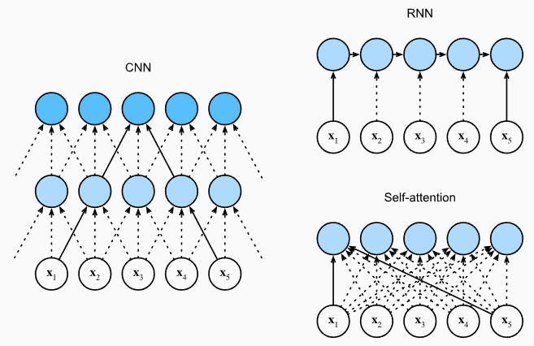
RNN vs CNN vs self-attention
RNN (O(Nd²)):
long term dependencies
cannot be parallelized
bias towards recent past (due to linear interaction time between distant elements)
CNN (O(kNd²)):
local features (n-gram detector)
linear/logarithmic interaction time between distant elements
self-attention (O(N²d)):
long term dependencies
equal preference for distant or recent past (constant interaction time)
more interpretable
computation grows quadratically with sequence length
source

Slide 80
Checkpoint 2 - text classification starting from word embeddings
Simple baseline = MLP over bag of word embeddings
however, averaging/summing word vectors discards temporal order
use RNNs to aggregate word embeddings sequentially
use last hidden state to classify
train bidirectional LSTMs and use last hidden states in each direction to account for beginning and end of sentence
train bidirectional LSTM+maxpooling to reduce positional bias
use 1D CNN with maxpooling
can capture n-grams that are informative regardless of their position
use self-attention to combine word embeddings

Slide 81
Word embeddings drawbacks
Sensitive to small differences: apple vs apples
Cannot handle polysemy (go home vs let’s play go):
this is why they are also called static embeddings or context-free embeddings
Cannot represent out-of-vocabulary words (fantastik)
but can be enriched with subword information (character n-grams) (Bojanowski et. al 2017)
Encode biases found in text:
sim(black, criminal) > sim(white, criminal)
sim(man, doctor) and sim(woman, nurse) high

Slide 82
NN for classification from word embeddings
‘play’ can be a verb or a noun depending on its context, however it is mapped to the same vector
neural network has to:
learn to disambiguate ‘play’/’like’ etc
aggregate features into a document vector
0.83 positive review
0.17 negative review
document vector
FC
neural network
play

Slide 83
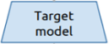
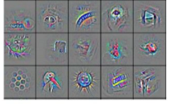
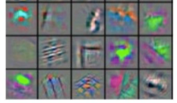
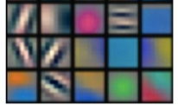

Transfer deep features in CV vs NLP
...
high level features
we’d like to learn these features as well during pretraining
opened .
books.
students.
contextual word embeddings
mid level features
their .
opened .
books .
low level features
students .
word embeddings
their .
students opened their books

Slide 84
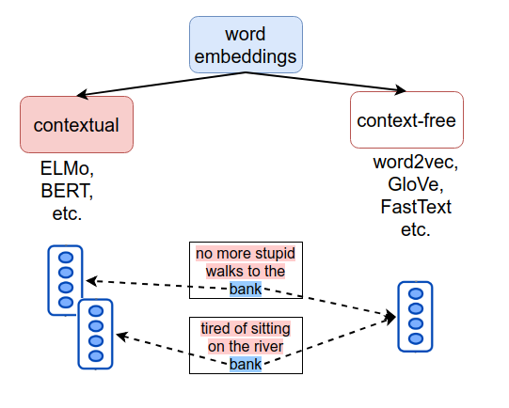
Word embedding types
context-free: each word has a single, static embedding, regardless of the word’s context
contextual: each word has different embeddings, depending on the word’s context

Slide 85
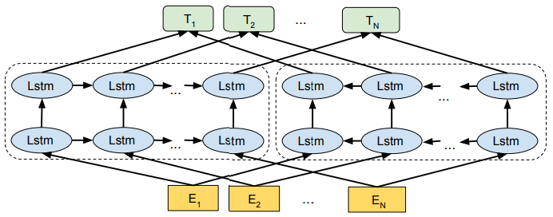


Recipe for contextual word embeddings
architectures
self-supervised tasks
lots of data
Predict future from past:
I wonder what to say ____
Fill-in-the-blank:
I feel like ____ is missing
based on recurrent networks (ELMo)
based on Transformer (BERT)

Slide 86
RNN hidden states revisited
each hidden state h_{t} can be seen as:
document embedding for the ‘document’ d=[x₁, x₂, …, x_{t}]
contextual word embedding of x_{t} (embedding of x_{t} that takes into account its left context x₁, x₂, …, x_{t-1})
source

Slide 87

Visualizing hidden states
hidden state h₃
document embedding of ‘What time is’
contextual word embedding of ‘is’ (made from the static word embedding of ‘is’ and the document embedding of ‘What time’)
source

Slide 88
Visualizing hidden states
contextual word embeddings:
h₁- contextual embedding of ‘What’
h₂- emb. of ‘time’ (that knows about ‘What’)
h₃- emb. of ‘is’ (that knows about ‘What’ and ‘time’ )
h₄- emb. of ‘it’ (that knows about ‘What’, ‘time’ and ‘is’ )
h₅- emb. of ‘?’(that knows about ‘What’, ‘time’, ‘is’ and ‘it’)
source

Slide 89


Language Model
task: predict the next word, given the previous ones
reverse task: predict past from future

Slide 90


Recurrent language model
t=4:
input: the, students, opened, their
output: probability distribution over all words in the vocabulary
label: laptops
loss: -log P(laptops|...)

Slide 91

Recurrent language model training
total loss: -log likelihood of correct word over all timesteps:
model learns rich representation in hidden states
h⁽³⁾ is a contextual word embedding for ‘opened’:
it contains information from the static word embedding of ‘opened’
contains information from its left context (‘the’, ‘students’) via h⁽²⁾
students
...
...
...

Slide 92

Bidirectional contextual word embeddings
train separate left-to-right and right-to-left deep RNN language models
concatenated hidden states provide deep, bidirectional contextual representations
figure from http://jalammar.github.io/illustrated-bert/

Slide 93

ELMo (Peters et. al 2018)
mix bidirectional hidden states from all depths
lower level hidden states capture syntax, while higher level hidden states capture semantic aspects
plug ELMo vectors in the target task model and fine-tune ƛ coefficients
figure from Transfer Learning in Natural Language Processing, by Sebastian Ruder

Slide 94

Visualizing and Measuring the Geometry of BERT (Coenen et. al 2019)
contextual word embeddings for ‘die’ (in different contexts)

Slide 95


Transfer shallow vs deep features from RNN-LM
train these weights
target task model
target task model
transfer
shallow features:
word embeddings
transfer deep features:
word embeddings + contextualized word embeddings
Notes:
In computer vision we transfer ‘backbones’, but in NLP we only transfer one embedding layer (prior to 2018)

Slide 96


Word embeddings taxonomy
type
model
context
task
Notes:
Recurrent-based contextual representations work well, but can we do without RNNs?

Slide 97

Self-attention blackbox
maps N input vectors x⁽¹⁾, x⁽²⁾, …, x^{(N)} to N output vectors y⁽¹⁾, y⁽²⁾, …, y^{(N)}
each output vector y^{(i)} incorporates context from all input vectors x⁽¹⁾, x⁽²⁾, …, x^{(N)}
knows about ‘The’, ‘Broadway’, ‘premiered’ and ‘yesterday’
contextual word embeddings
word embeddings

Slide 98

Modern transfer learning in NLP
transfer pre-trained deep models, which:
are based on the Transformer block
are trained with self-supervised tasks
encode deep contextual embeddings
fine-tuning these models for each specific task leads to large performance improvements
depth = 24 blocks

Slide 99

BERT (Bidirectional Encoder Representations from Transformers)
network produces deep contextual word embeddings using 24 stacked Transformer blocks
fine-tuning BERT results in state-of-the-art on 11 NLP tasks

Slide 100

BERT training task 1
Masked Language Modeling (MLM): mask 15% of input words and then predict them
output vectors T_{i} incorporate bidirectional context (unlike LM task)
...
...
T₁
T₂
T₅
T₅₁₂
BERT
figure from http://jalammar.github.io/illustrated-bert/
Notes:
BERT naturally incorporates bidirectional context, via the MLM task and bidirectionality of self-attention.

Slide 101

BERT training task 2
Next sentence prediction (NSP): given two sentences A and B, does B follow A?
subsequent papers (RoBERTa - Facebook) showed NSP objective can be removed
figure from http://web.stanford.edu/class/cs224n/slides/Jacob_Devlin_BERT.pdf

Slide 102

Input representation
add token, segment and position embeddings
special tokens:
[CLS] beginning of sequence

Slide 103
Input representation
add token, segment and position embeddings
special tokens:
[CLS] beginning of sequence
[SEP] separates two sentences/segments

Slide 104

BERT for sentence embedding
[CLS] token is ‘neutral’
h_{[CLS]} is obtained from [CLS] ‘attending’ to all the other tokens
h_{[CLS]} is thus a sequence representation and can be used for classification

Slide 105

Pretrain-finetune paradigm
pre-train model on large data (Wikipedia - 2.5B words + BookCorpus - 800M words)
fine-tune separate models for each classification task

Slide 106
Transfer deep features in CV vs NLP
...
high level features
learn hierarchical features using stacked Transformers or RNNs
opened .
books.
students.
contextual word embeddings
mid level features
their .
opened .
books .
low level features
students .
word embeddings
their .
students opened their books

Slide 107

Word embeddings taxonomy
type
model
context
task
Notes:
Recurrent-based contextual representations work well, but can we do without RNNs?

Slide 108
Recurrent language model recap
use RNN to encode words
at train time, predict next word x^{t+1} from each hidden state h_{t}
at test time, sample a word at each time step and feed it back to the model
students
...
...
...

Slide 109

GPT: Transformer language model
same objective as RNN LM, but encode input using masked self-attention (each word can only ‘attend’ to previous words)
showed that Transformer LM are an effective pretraining technique for downstream tasks
orders
source: https://jalammar.github.io/illustrated-gpt2/

Slide 110

Scaling Language Models
Trends:
larger and larger models (up to 530B )
models trained on more and more data (trillion tokens)
source: DistilBERT

Slide 111

What does the LM task learn under the hood?
source: Stanford CS224N https://web.stanford.edu/class/cs224n/slides/cs224n-2023-lecture11-prompting-rlhf.pdf

Slide 112

Emergent behaviour
training with the LM objective makes the model learn general-purpose semantic features, which transfer well
however, when scaling them up, the models also start to exhibit an ability to solve general tasks in a zero-shot/few-shot way
1-shot example fromhttps://arxiv.org/pdf/2206.07682.pdf

Slide 113

In-context learning (GPT3)

Slide 114

GPT3
performance increases with:
more examples shown in context
larger models
finetuned task-specific models outperform LLMs, but they still require training examples and gradient updates
Large Language Models (LLM) however are general-purpose task solvers

Slide 115

LLM generate falsehoods
source: TruthfulQA

Slide 116

LLM outputs are not helpful
solution: finetune LLM to follow human feedback!
source: TruthfulQA

Slide 117

InstructGPT (based on GPT3.5)
finetune LLM on human collected instructions
use human feedback to learn a reward model to rank LLM outputs
use RL to align LLM to human preferences, by using the signal from the reward model
source: Scaling Instruction-Finetuned Language Models

Slide 118

InstructGPT (based on GPT3.5)
finetune LLM on human collected instructions
use human feedback to learn a reward model to rank LLM outputs
use RL to align LLM to human preferences, by using the signal from the reward model
source: InstructGPT

Slide 119

InstructGPT (based on GPT3.5)
source: https://openai.com/research/instruction-following

Slide 120

chatGPT = InstructGPT + dialogue instructions

Slide 121
NLP paradigms
[2013-2017] architecture engineering:
use static word embeddings as a starting point
train task-specific models on top of these shallow features
[2018-now] pretrain-finetune:
pretrain a LM/MLM to learn deep contextual word embeddings
add task-specific layers to this backbone and finetune separate models for each task
[2020-now] Large Language Models:
train a large language model
use it as a general-purpose language task solver, which performs tasks in zero-shot/few-shot setting

Slide 122
Word embeddings taxonomy
type
model
context
task
Notes:
Recurrent-based contextual representations work well, but can we do without RNNs?

Slide 123
TODAY
word embeddings:
vectors that capture the ‘meaning’ of words
vectors of similar words have high similarity
contextual word embeddings:
‘dynamic’ word vectors that change depending on the context
learned using RNN/Transformers with self-supervised tasks (e.g. language model, masked language model etc.)
large language models:
general-purpose language solvers that ‘implicitly’ learn to solve tasks

Slide 124
Thank you!
(Next: Unsupervised learning)

Slide 125
Resources for NLP with NNs
Textbooks:
A Primer on Neural Network Models for Natural Language Processing, Yoav Goldberg
Natural Language Understanding with Distributed Representation, Kyunghyun Cho
Speech and Language Processing 3rd edition, Dan Jurafsky and James H. Martin
Courses:
Stanford Deep Learning for NLP: http://web.stanford.edu/class/cs224n/
CMU Neural Networks for NLP: http://www.phontron.com/class/nn4nlp2020/

Slide 126
References
Word embedding papers:
Efficient Estimation of Word Representations in Vector Space, Mikolov et. al 2013
Contextual word embeddings papers:
ELMo: Deep contextualized word representations, Peters et al. 2018
Transformer: Attention is all you need, Vaswani et al. 2017
GPT: Improving Language Understanding by Generative Pre-Training, Radford et al. 2018
BERT: Pre-training of Deep Bidirectional Transformers for Language Understanding, Devlin et al. 2018
Large Language Models papers:
GPT3:
InstructGPT: https://arxiv.org/pdf/2203.02155.pdf
Survey: https://arxiv.org/pdf/2303.18223.pdf

Slide 127
References (2)
Presentations:
Deep Learning Meetup March 2020: slides
Blogs:
https://jalammar.github.io/illustrated-transformer/
https://jalammar.github.io/illustrated-bert/
https://ruder.io/nlp-imagenet/

Slide 128


Language Model
Task: predict the next word, given the previous ones:

Slide 129

Language Models in action
Predictive typing Text generation
“The Malfoys!” said Hermione.
Harry was watching him. He looked like Madame Maxime. When she strode up the wrong staircase to visit himself.
Picture from https://www.pressstart.co.uk/blog/predictive-typing-tips
Text from https://medium.com/deep-writing/harry-potter-
written-by-artificial-intelligence-8a9431803da6

Slide 130



RNNLM inputs and labels
Inputs:
Ground truth labels:
S
NMT tutorial ACL 2016, Luong, Cho and Manning

Slide 131
char-RNNLM feedforward
output distribution:
Ŷ^{(t)} = P(x^{(t+1)}|x⁽¹⁾, x⁽²⁾, …, x^{(t)})
= softmax(Uh^{(t)}+b) ∈ R^{|Vocabulary|}
hidden state:
h^{(t)} = RNN(e^{(t)}, h^{(t-1)}) ∈ R⁵¹²
character embedding:
e^{(t)} ∈ R¹²⁸
character input:
x^{(t)}∈ {0, 1, 2, 3, …, |V|-1}, V is vocabulary
b
h
d
...
...
c
a
...
t
h

Slide 132


RNNLM training (2)
Expensive to compute losses over all corpus and backpropagate
In practice, losses computed over a mini-batch of sequences (16/32/64)

Slide 133
RNNLM training (2)
Expensive to compute losses over all corpus and backpropagate
In practice, losses computed over a mini-batch of sequences (16/32/64)
first iteration, batch = 4

Slide 134
RNNLM training (2)
Expensive to compute losses over all corpus and backpropagate
In practice, losses computed over a mini-batch of sequences (16/32/64)
second iteration, batch = 4

